Slide 1
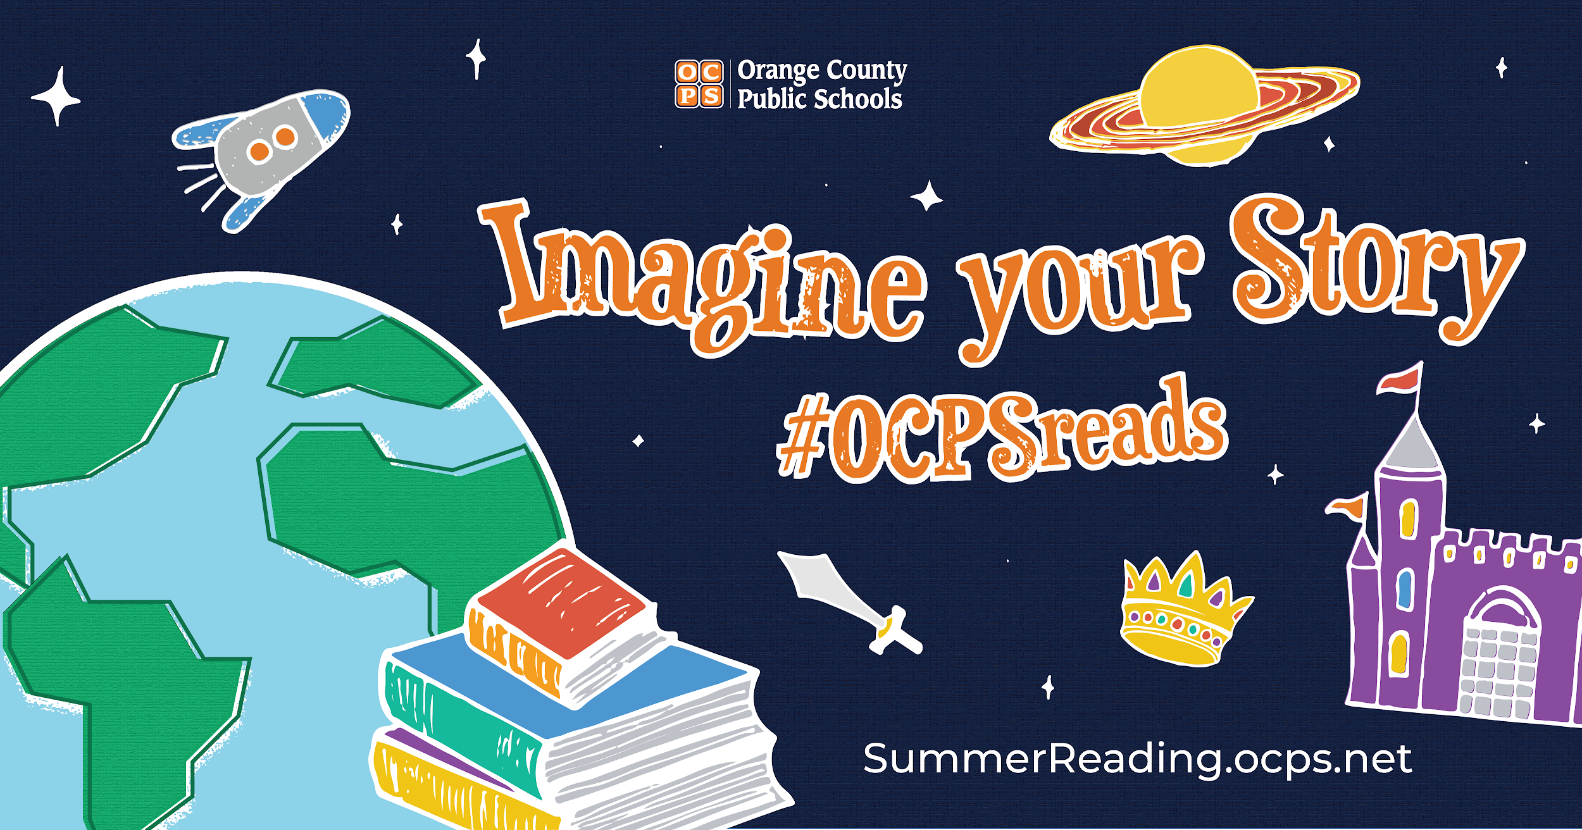
2020 Summer Reading Challenge!
Notes:
SAY: Welcome

Slide 2
Information About Summer Reading
Our theme: Imagine Your Story
The Summer Reading Challenge will begin May 27th and end August 10th.
Students will need to continue logging their minutes via Beanstack.
Our Goal: Over 1 million logged minutes and over 3,000 students logging their reading.
Notes:
Nicole
SAY: As we know, this year’s summer reading kickoff is a little different from previous years, but we want to be sure students will continue to receive the proper information and continue to read this summer.
SAY: Our theme this year is “Imagine Your Story”.
SAY: Our Summer Reading Website has been updated with various resources for students and parents.
SAY: On the website, you will find links to Beanstack, OCLS Summer Reading program, and the SSYRA reading lists for students.
SAY: Students will also be able to view the student “How to” video on how to navigate through Beanstack.
SAY: During our Winter Challenge, we recorded 415,741 minutes and only 600 readers logging minutes.
SAY: Our goal for this year is to have over 1 million logged minutes from students and to also have 3,000 students logging their reading.
SAY: We had created this goal before Distance Learning began.
SAY: In our Spring into Reading Challenge so far, we have recorded over 1,800,000 minutes and 4,564 readers logging their minutes.
SAY: I believe that we can do even better than the Spring into Reading challenge.

Slide 3
Promo Video about The Summer Reading Challenge
Summer Reading Promo
Notes:
Nicole
Do: Present Summer Reading Promotional.
https://www.youtube.com/watch?v=7u5fkFAC2Lk&list=PLX3LSBP9fUiugtjQmhiL__ddg44jn646W
SAY: We have created a promotional video for our summer reading challenge to share. It is a brief video that goes over the challenge, resources, and our goal.
SAY: The link directs you to the Social Media kit which contains this video and has also been translated in Spanish, Portuguese, and Haitian Creole.
SAY: To help you with promoting Summer Reading, we have created a Social Media Kit. This is linked on the Google Slide deck and can also be found on our Summer Reading website.
SAY: This kit contains sample posts and graphics for each area in social media such as Facebook, Twitter and Instagram. The graphics’ layout are the appropriate size for each medium as well.
SAY: These are just sample posts to help you. You can tweak them to fit your needs.
SAY: You will also find additional resources at the bottom along with our information if you have any questions.
SAY: I have also attached the Summer Reading Customizable flyer. This contains the information previously shared for students on logging into Beanstack and using the app.
**Do: Screenshare of Social Media Kit**

Slide 4
Prizes for Summer Reading 2020 #OCPSreads
Categories
Overall
Learning Community (5)
High School
Middle School
Elementary School
1st Place: Kindle (9 Total) 2nd and 3rd Place: Books & Gifts
Notes:
Margie
SAY: We are very excited to announce our Summer Reading Challenge will have some great incentives as prizes this year.
SAY: In years past, prizes have been awarded to only three students for the overall reading minutes. This year, thanks to some generous sponsorships, OCPS will reward students in several categories. 9 students will receive Kindles for earning the highest reading minutes overall, a winner in each of the grade level bands: high school, middle school and elementary school and winners in each learning community. So, overall the 1st place winners in each category will be receiving a Kindle. Students in those categories who earn 2nd and 3rd place honors will be receiving books and other “bookish” items like bookmarks and the like.
SAY: We’re very excited and encourage schools to offer incentives as well. A free yearbook, free books from your Scholastic book fair and many more low cost rewards can be a great way to motivate readers. Simpy recognizing those readers on the morning announcements or on your school’s social media are free and easy ways to recognize reading!

Slide 5
2020 Summer Reading Challenge Information
Hey Odyssey Middle School Dragons, Keep Reading!
Odyssey Middle School is raising the bar for reading with our Summer Reading Challenge! At Orange County Public Schools, we are building readers, and we want our students to continue reading all year long! All our students need to do is simple: choose a book to read, read the book, and track that reading in Beanstack.
Read for pleasure, to find out, or to defend a point of view. Read to persuade, laugh, cry, and to understand. Read novels, newspapers, comics and more. Read, read, read anything! Just be sure to log your minutes and books read!
Notes:
Nicole
Do: Present Summer Reading Promotional.
https://www.youtube.com/watch?v=7u5fkFAC2Lk&list=PLX3LSBP9fUiugtjQmhiL__ddg44jn646W
SAY: We have created a promotional video for our summer reading challenge to share. It is a brief video that goes over the challenge, resources, and our goal.
SAY: The link directs you to the Social Media kit which contains this video and has also been translated in Spanish, Portuguese, and Haitian Creole.
SAY: To help you with promoting Summer Reading, we have created a Social Media Kit. This is linked on the Google Slide deck and can also be found on our Summer Reading website.
SAY: This kit contains sample posts and graphics for each area in social media such as Facebook, Twitter and Instagram. The graphics’ layout are the appropriate size for each medium as well.
SAY: These are just sample posts to help you. You can tweak them to fit your needs.
SAY: You will also find additional resources at the bottom along with our information if you have any questions.
SAY: I have also attached the Summer Reading Customizable flyer. This contains the information previously shared for students on logging into Beanstack and using the app.
**Do: Screenshare of Social Media Kit**

Slide 6
Three Steps to Get Started - The Challenge Begins on May 27
Step one. Sign in to Launchpad. Select Beanstack.
Step two. Log Minutes and Books Read. Select the ‘Log Reading’ button on the page and enter the material read, along with the total number of minutes and the title of what you have been reading (book, newspaper article, etc.)
Step three. Earn Virtual Badges and Recognition. As you log reading, you will earn virtual badges and special recognition at school.

Slide 7
There’s Also an App For That
To Download the Beanstack Tracker App, visit the Apple App Store or Google Play Store and search for ‘Beanstack’. Or scan the QR code at the bottom of the page to get taken right there!
Click ‘Get Started’ & Select the ‘Schools’ tab.
Search for your school and select it.
Sign in using your typical username, using your last name as the password.
Using the app you may scan the books you read and more easily track your reading sessions!

Slide 8
Summer Reading Website
summerreading.ocps.net
Notes:
Nicole
SAY: Our Summer Reading Website has been updated with various resources for students and parents.
SAY: We have continued to partner with OCLS and ZooBean in helping promote Summer Reading.
SAY: Students will continue to be able to check out eBooks in OCLS with their virtual library card.
SAY: The hyperlinked Beanstack directs you to the Beanstack Canvas page that has various information and the student video on how to navigate through Beanstack.
SAY: On the website, you will find links to Beanstack, OCLS Summer Reading program, and the SSYRA reading lists for students.
SAY: Students will also be able to view the student “How to” video on how to navigate through Beanstack.
**Do: Screen Share to show the Summer Reading Website**

Slide 9
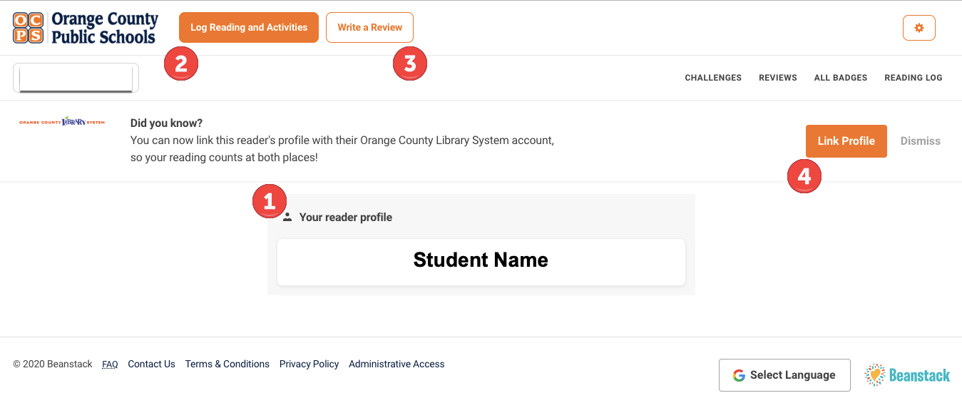
Beanstack Reader Profile
Check out the Beanstack Student Guide for more step by step information.
Notes:
Nicole
SAY: Beanstack is what students would use to log their minutes.
SAY: Here we have a snapshot of the students Reader Profile.
SAY: From this page, students can access their challenges, log their minutes, write a review, and link their profile to their OCLS account.
SAY: Beanstack is easy to navigate. We have also included the Beanstack Student Guide to help them with step by step information on logging their minutes.
SAY: Remember that these documents were created in the OCPS domain, so you will need to use your OCPS credentials to access them.
SAY: If you are sharing these with parents or anyone outside of OCPS, you would need to download them as a PDF and then share out.

Slide 10
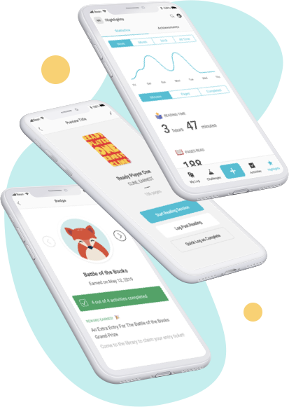
Beanstack App Login
Download the App | Get Started | Login
Visit the Apple App Store or Google Play Store and search for ‘Beanstack’ | Click ‘Get Started’ & Select the ‘Schools’ tab. Search for your school and select it | Student Login Username: Student id # Password: last name, all lowercase Teacher Login Username: Personnel # Password: beanstackreads
Notes:
Nicole
SAY:“Fitbit for Reading” Mobile App
SAY: The one-of-a-kind Beanstack app lets students time reading sessions, log books by scanning their ISBN numbers, keep a log of current and past reading, track daily reading stats, and achieve streaks for reading multiple days in a row. Via the app, parents are able to assist younger students with their logging, helping foster a true reading community.
SAY: Here are the steps for using the Beanstack app.
SAY: To Download the Beanstack Tracker App, visit the Apple App Store or Google Play Store and search for ‘Beanstack’.
SAY: Click get started and then search for your school.
SAY: You will then login using the credentials listed for either students or teachers.
SAY: Using the app you may scan the books you read and more easily track your reading sessions!

Slide 11
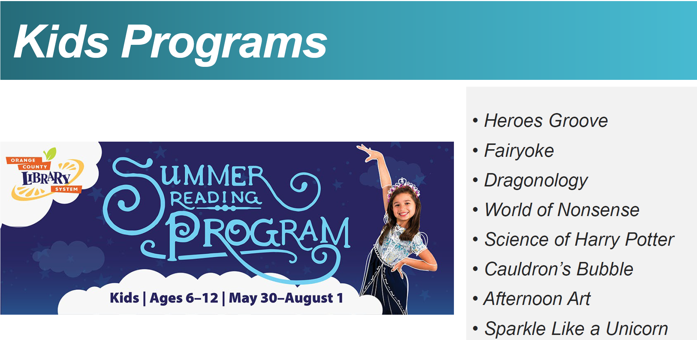
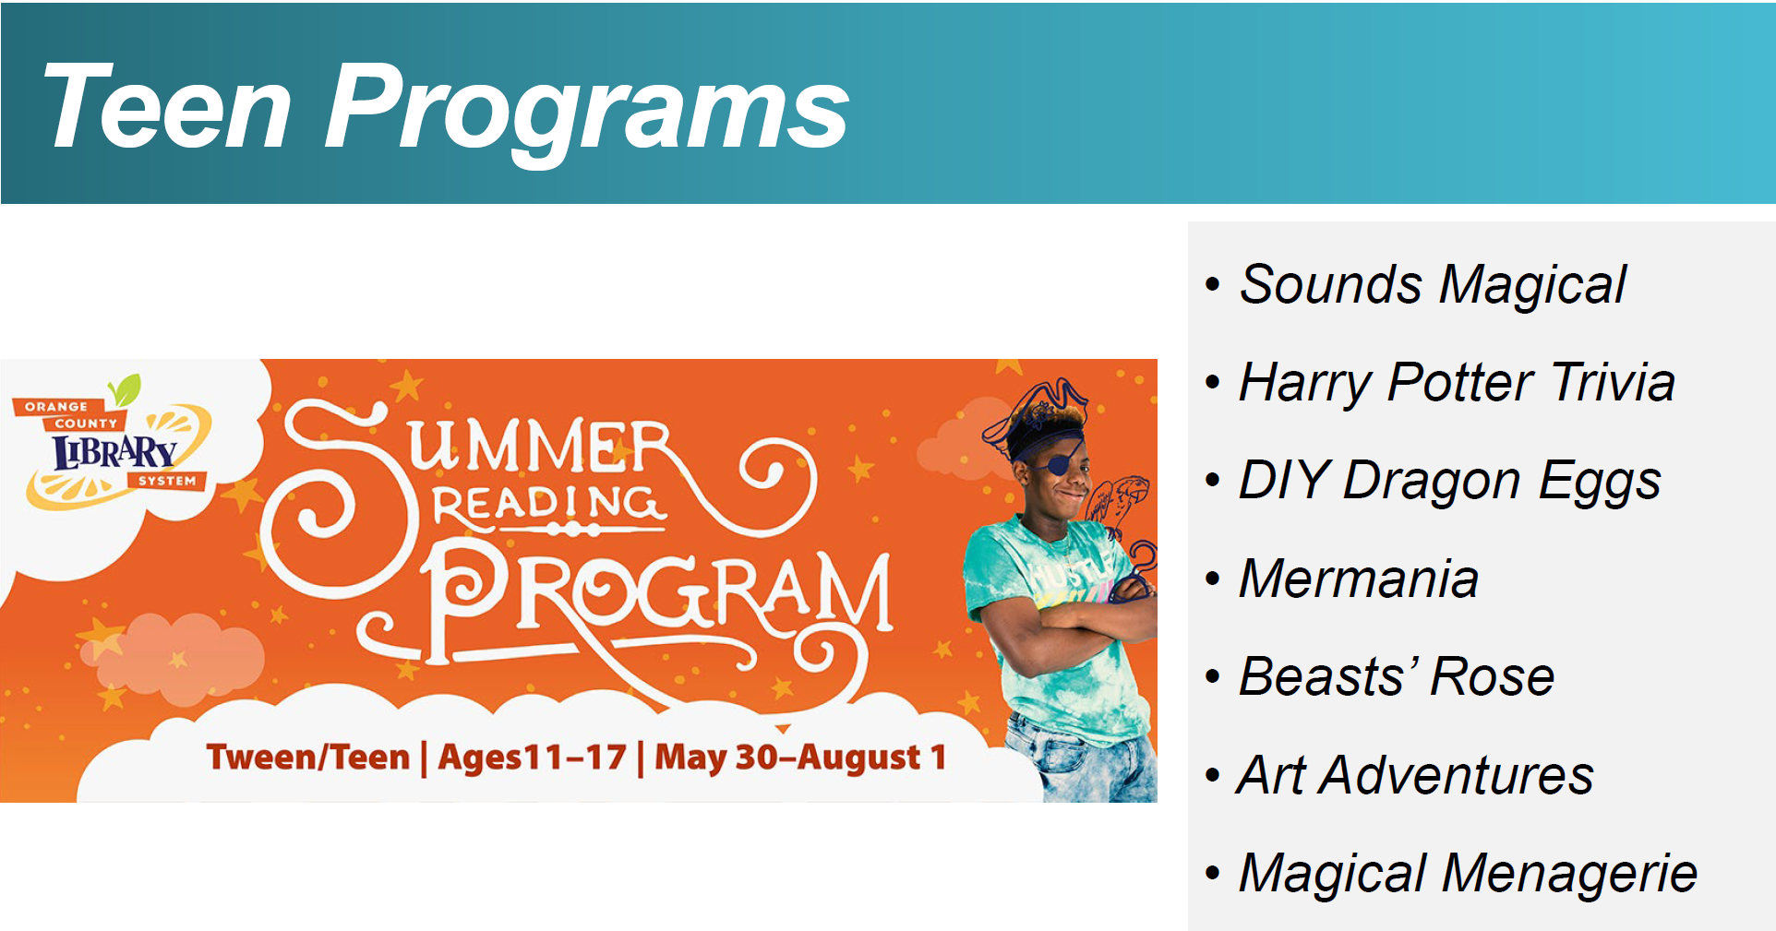
Orange County Library Services Summer Reading Program
The OCLS Summer Reading Information PDF has all the details!
OCLS 600 Minute Reading Challenge
Read 20 minutes per day
Use the Beanstack app or the paper form to track minutes.
Virtual Events for All Age Groups
Join the events on Zoom for Live events
Pre-registration and a OCLS Library Card is required
Activity and Craft Kits
Hands-on Projects to do at home
Available at any branches of the OCLS, while supplies last.
Notes:
Margie:
Before we move on with more of the OCPS Summer Reading program, we’d like to share a bit about the Orange County Library Services summer program.
SAY: As we will mention shortly, OCLS provides a Virtual Library Card to all OCPS Students. We will provide more information about that resource program in a moment.
SAY: OCLS is challenging students to read 600 minutes each by reading just 20 minutes per day during the summer. As we mentioned, our Beanstack app links with OCLS so students can participate in both challenges simultaneously. They are also utilizing the theme: Imagine Your Story as you can see from their beautiful graphics promoting virtual events.
SAY: OCLS is providing a paper tracker for logging reading minutes for students who aren’t able to utilize Beanstack online. It is available at the link on the slide and within the information document OCLS shared linked at the bottom of the page.
SAY: OCLS is also hosting virtual events for all age groups including pre-school. They are offering hands-on activity and craft kits at each of the OCLS branch locations. For more information about their Summer program, click on the Information PDF link provided on this slide.

Slide 12
OCLS Virtual Library Card
Orange County Library System’s Virtual Library Card
Accessible for OCPS students and teachers via LaunchPad
K-5 Flyer (Spanish version included)
6-12 Flyer (Spanish version included)
Notes:
Margie
SAY: The Orange County Library System offers a Virtual Library Card to ALL OCPS students and staff members. The virtual library card provides students (and teachers) with thousands of ebook resources even if they don’t have a library card with the public library. However, if students and staff want a full membership to the OCLS - they can, of course, apply for a library card with the public library.
SAY: There are links in this presentation to the VLC information for students with their login and password format. The format for the login and password are also available at the top of both of these documents. There is a flyer for elementary students and a different one for secondary students and a Spanish version of each was provided by OCLS as well.
SAY: The VLC resources are also available to OCPS staff members. Just use your personnel number and the last four digits of the personnel number for their pin.

Slide 13
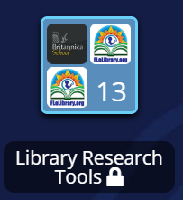
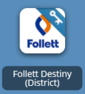
Destiny Discover eBooks
OCPS LaunchPad
Library Research Tools
Follett Destiny (District)
eBooks for Students Guide
Notes:
Margie
SAY: Orange County Public Schools offers students and teachers access to eBooks via the Destiny Discover app located on LaunchPad.
SAY: Each school has access to thousands of eBooks including Sunshine State books and Florida Teen Reads titles!
SAY: We have created a student friendly guide on how to access eBooks in Destiny and using the Destiny Read application.
SAY: Be sure to promote these resources and check out our BigBlueButton session presentation to help you with:
How to use Destiny Discover and read in the browser
How to download an eBook
And How to use the Destiny Read App
SAY: These can be great starting points or guides for your faculty.
SAY: You can also make a copy of this presentation to share with your faculty and staff. Remember the link to the Slide Stack is in the Shared Notes section of the BBB session.

Slide 14
Using the Destiny Read App
Available for iOS and Android devices.
It accesses and downloads CHECKED-OUT Follett eBooks and Audiobooks.
Users must go to Destiny Discover via LaunchPad to checkout eBooks before using the app on their phone or other devices.
Notes:
Margie
SAY: The Destiny Discover Read app is available for iOS and Android devices.
SAY: It accesses and downloads books that are already checked-out from the DESKTOP version of Destiny Dicover.
SAY: The Destiny Read App only allows users to read a book that has already been checked out using the desktop version of Destiny.
SAY: So, to prepare to read the title on a phone or tablet, users must go to Destiny Discover via Launchpad to checkout eBooks first.

Slide 15
Additional eBook Resources
Project Gutenberg Project Gutenberg is a library of over 60,000 free eBooks. Thousands of volunteers digitized and diligently proofread the eBooks, for enjoyment and education. | Harry Potter at Home Students are able to follow along or listen to Harry Potter and the Philosopher’s Stone/ Sorcerer's Stone. | Destiny Discover eBooks List This is a list created for teachers and students of the eBook SSYRA and FTR titles supplied by the district for the last three years.
Notes:
Margie
SAY: Project Gutenberg is a library of over 60,000 free eBooks. Choose among free epub and Kindle eBooks, download them or read them online. SAY: You will find the world's great literature here, with focus on older works for which U.S. copyright has expired. Thousands of volunteers digitized and diligently proofread the eBooks for enjoyment and education.
SAY: Project Gutenberg eBooks require no special apps to read, just the regular Web browsers or eBook readers that are included with computers and mobile devices.
SAY: Another great resource right now is the “Harry Potter at Home” website. JK Rowling and her publisher are offering free access to the eBook and audiobook version of Harry Potter and the Sorcerer's Stone, the first book in the series.
SAY: Chapter one of the Sorcerer's Stone is available and is read by the star of the movie version, Daniel Radcliffe.
SAY: The last resource provided on this page is a list of past Sunshine State and FTR titles that are available as eBooks. Although these are books from past year’s lists - there are multiple copies of these ebook titles.
SAY: Please encourage students and teachers to open and read the books not to check them out unless they absolutely have no internet at home.
SAY: Students may open and close a book then come back to it and still find their bookmarks etc. Doing this keeps the copies available to share with everyone based on the number of copies we purchased.

